Slide 1
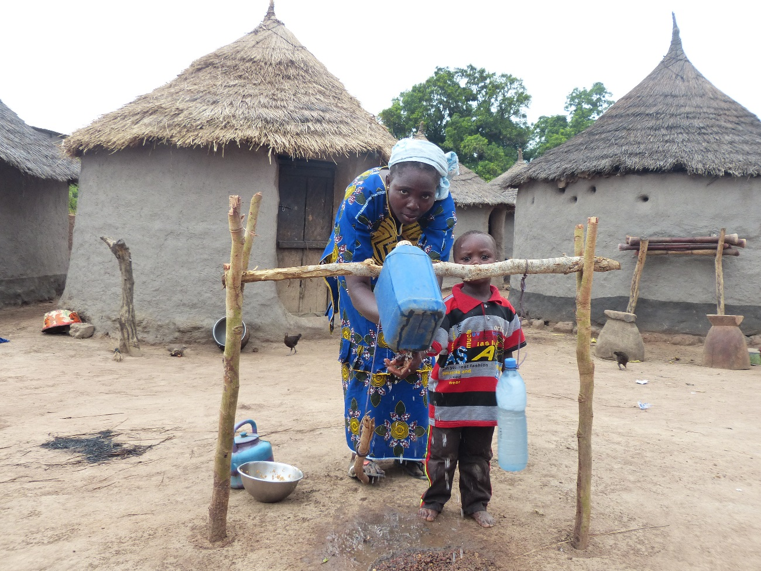
Behavior change workshop – Session 2
2016
Based on the Eawag presentation

Slide 2
Phase 1
Evidence based behavior change protocol
Phase
Define the behavior to be changed and the target population to be tackled
Conduct qualitative interviews about the favoring and hindering contextual factor of the behavior
Allocate behavioral factors to the factors of the RANAS Model
1. Define potential behavioral factors
Notes:
To start the process it is very important to have clarity about the behavior we want to target.

Slide 3
Defining a behavior
Evidence based behavior change protocol
➔ Behavior = sequences of actions of the target population
➔ Action = performed activity
Define beginning and end of behavior
State it precisely:
    Preparatory behavior
    All the steps
Measurements of behavior:
    Observation of the performance
    Observation of outputs (e.g. bottles in the sun)
    Calculating self-indications (% of consumed water)
    Self-reporting
Notes:
What is a behavior? It is important to clearly define it and see is a sequence of actions. We have many different definition of a behavior in our minds and we need a common understanding. It is helpful to use a personal behavior discussed in the first session to illustrate this. Discussion has to take place about where the behavior starts, what the different steps are, are there pre-steps necessary. For example, is building a latrine and using a latrine one behavior? Is cleaning a toilet a separate behavior or a preparatory behavior? Etc.
Then, measuring a behavior is not so easy. We will not enter the latrine with the person to see if she is performing the behavior correctly, so we need also observation, self-reporting and proxy indicators to measure it.

Slide 4
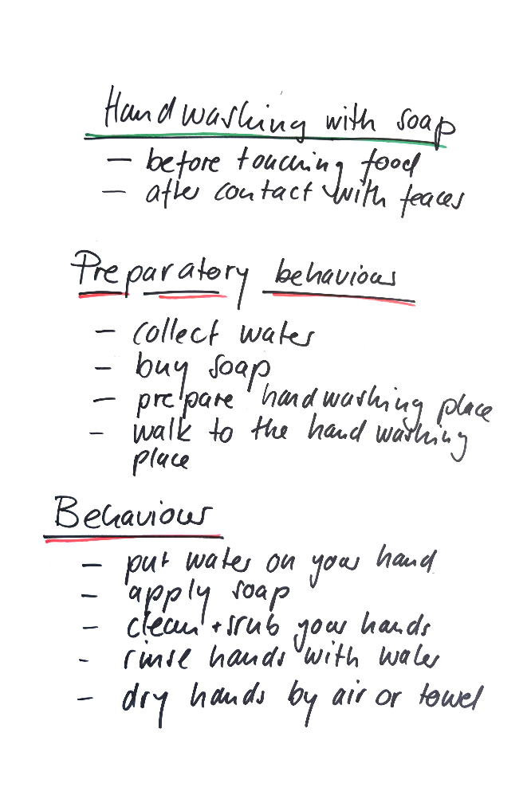
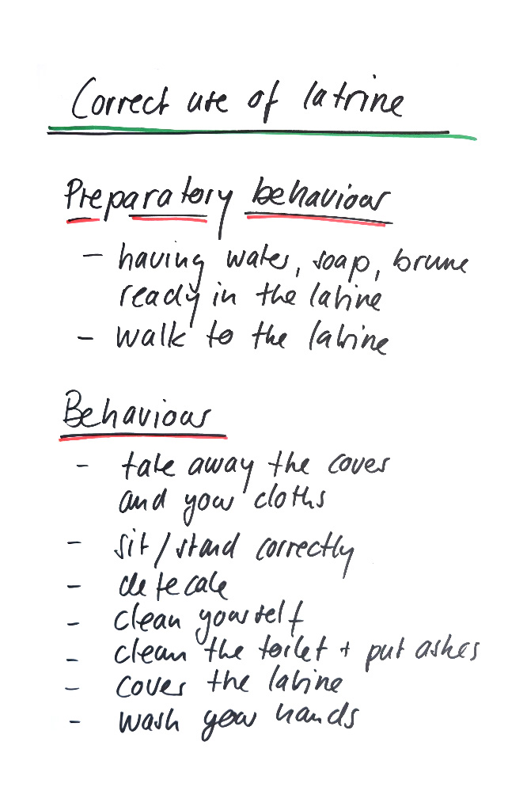
Example of behavior description

Slide 5
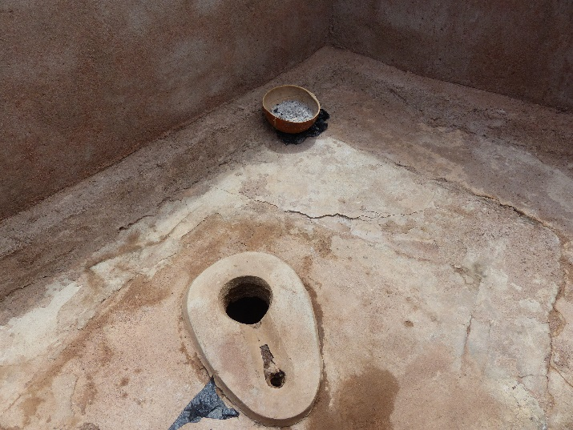
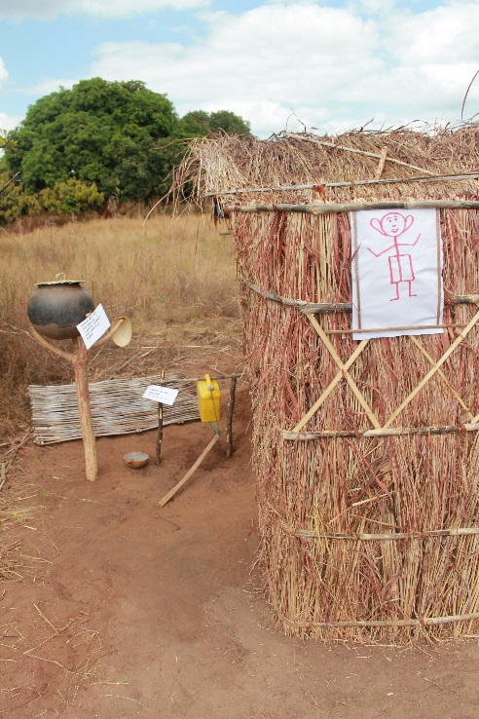
Example of sanitation behaviors
(Avoiding) open defecation
Building or purchasing toilets
Improving toilets: cover, lock
(Avoiding) inappropriate use
Cleaning
Emptying or paying for service

Slide 6
Example of hygiene behavior
Handwashing after contact with feces: after defecation, after wiping a child’s bottom, after disposing of feces.
Handwashing before handling food: before eating, before preparing food, before feeding a child, before handling drinking water.
Food hygiene: hygienic handling and cooking of food; clean cookware as well as safe storage of food so that animals and especially flies don’t have access.
Body hygiene: washing the body with water and soap, trimming fingernails, wearing clean clothes and menstrual hygiene.
Housing hygiene: safe storage of cookware, cleanliness of floors and close surroundings of the house.

Slide 7
Defining the target population
Who is most important in changing behavior?
Women
Men
Primary caretaker
Children
Pupils
Leaders
Most vulnerable
Which people are to practice the target behavior?
Whose behavior has the greatest influence on the family?
Who has the greatest influence on others‘ behavior?
Notes:
We need to define the target population with the highest influence on the behavior, because we will have to orient our interventions toward them. These questions have to be discussed in a mixed group whose members have good knowledge of the local condition and culture.

Slide 8
Task 1
Definition of the behavior and the target population
Goal: Describe precisely the behavior and the target population
Task:
  Define the sequence of action of the behavior with all the activities involved
  Define the most important actors for the behavior change
Process:
  Discuss in groups for 15-20 minutes
  Present your results
  Define an agreed solution in plenary
Notes:
It helps to have a good mix in the group. The final discussion is important in order to reach a common understanding. The result will form the basis for the following step.

Slide 9
Contextual factor of the behavior
Information behavior change techniques
Risk factors:
Health knowledge
Vulnerability
Severity
Behavior A
Intention
Use
Habit
Persuasive behavior change techniques
Attitude factors:
Beliefs about costs and benefits
Feelings
Norm behavior change techniques
Norm factors:
Others’ behavior
Others’ (dis)approval
Personal importance
Behavior B
Intention
Use
Habit
Infrastructural, skill & ability behavior change techniques
Ability factors:
How-to-do knowledge
Confidence in performance
Confidence in continuation
Confidence in recovering
Planning & relapse prevention behavior change techniques
Self-regulation factors:
Action planning
Action control
Barrier planning
Remembering
Commitment
Social context
Physical context
Personal context
Notes:
We have to be aware that the enviromental context has an influence on the behavioral factors and the performence of the behavior. The context is divided into social, physical and personal aspects.

Slide 10
Contextual factors
Collect information via qualitative interviews, group discussions or observation
Social context | Culture and social relations, e.g. taboos, rites, or norms. Laws and policies, e.g. prohibition of open defecation, water rights, school budget for hygiene supplies, curriculum on WaSH behavior. Economic conditions, e.g. household or community wealth. Product and service accessibility, e.g. price of soap, water, or infrastructural facilities; availability of soap; reliability of water services. Information environment, e.g. health information shared in the health center or in schools.
Physical context | Natural environment, e.g. climate, seasons, water occurrence or soil condition. Built environment, e.g. well, latrine, handwashing station.
Personal context | Socio-demographic factors, e.g. age, sex, and education. Physical and mental health of the person.
Notes:
Here are some examples for the different categories. As an example in Mali the tradition to wash hand in a common vessel without soap was identified. In Benin the integration on hygiene education in the school curriculum was considered as a positive influence

Slide 11
Task 2
Collect information about facilitating and hindering contextual factors
But: Know-how about the conditions and the factors facilitating or hindering the behavior
Task and process:
  Work in groups of 4-6 persons for 30 minutes
  Collect the contextual factors facilitating and hindering the chosen behavior
  Identify information gaps. What kind of extra information do we need and how can I get it (interviews, group discussion, observation)?
  Present the results
Notes:
During this work, be aware that a contextual factor can have a positive or negative influence on the behavioral factors. Please use the following table to present your results.

Slide 12
Task 3
Classify the favoring and hindering contextual factor according to the RANAS model
But: Know-how about the interlinkages between environmental contextual factors and behavioral factors
Task and process:
  Work in groups of 4-6 persons for 30 minutes
  Classify the contextual factorsfacilitating and hindering the chosen behavior in the RANAS model (see table in the next slide).
  Present the results.

Slide 13
Task 3
Ranas factors | Contextual factor | Contextual factor group | +/- Influence
Risk factor
Health knowledge
Vulnerability
Severity | Cholera epidemic | Physical | + people are more aware
Attitude factors
Beliefs about cost/benefit
Feelings/emotions

Slide 14
Some definitions
Behavior | Description
Behavior | Perform waste separation
Intention | Readiness to do waste separation
Habit | Automatic performance of waste separation
Use | Usage of waste separation containers
Compliance | More than 90% of the waste is separated

Slide 15
Phase 2
Phase
1. Identify potential behavioral factors
2. Measure and define behavioral factors
2. Measure and define behavioral factors
  Develop a questionnaire to measure behavioral factors and behaviors, and conduct observations.
  Conduct a representative baseline survey.

Slide 16
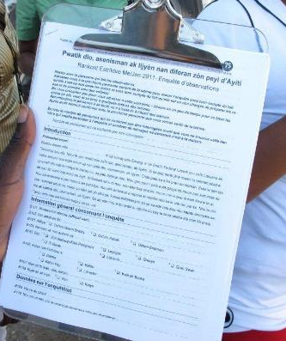
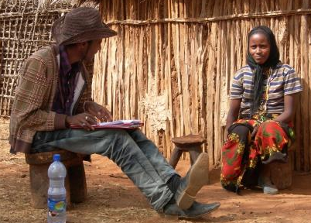
Next step - Measure behavioral factors
2. Measure behavioral factors
Develop a questionnaire to measure behavioral factors and behaviors, and conduct observations
Conduct a representative baseline survey
Face-to-face interviews
Based on standardized questionnaire
Aim is to collect detailed information about:
  The behavior
  Behavioral factors
Notes:
In order to measure a behavioral factor, a standardized questionnaire is used to collect information about the behavior itself, e.g. how the behavior is done, the frequency of the behavior, is there infrastructure to do the behavior, self reported behavior by the person, etc.
On the behavioral factors questions are ask about the five factors block (e.g. risk: Does the person know the cause of diarrhea?; attitude: Do they like the smell of the soap when washing their hands?; norms: How many people in their community wash their hands?; ability: Can the person show the correct way to wash one‘s hands?; and self-regulation: How committed is the person to washing their hands?. These are very specific questions or observations.

Slide 17
Types of questions: open questions
Can you tell me what causes diarrhea? ………………………………………
Ask open-ended question
Write down respondent’s answer
Notes:
Here are some example of different types of questions. With open questions you can gain the participants own answers and allows the exploration of the range of possible themes arising from an issue, including those we had not anticipated. The disadvantage of these question is that they are difficult to analyse and time consuming

Slide 18
Types of questions: open questions
Types of questions
In general, why do you wash your hands with soap/ash/sand and water?
□ Against bacteria □ Against diarrhea □ To protect our children/baby
□ Against dirt/smell □ Compliance/obligation □ Against sickness
□ To protect health □ Because of hygiene □ Group behavior
□ Habit □ Don’t know □ Other ……………….
Ask open-ended question
Based on the answer, the interviewer selects the corresponding answer category
Open questions with given answer categories (multiple response)
Notes:
This is an open question with answer categories. Its advantage compared to the previous question is that responses are pre-categorized to facilitate data analysis.

Slide 19
Types of questions: closed questions
Types of questions
Do you wash your hands with soap/ash/sand and water after contact with stool frequently?
Ask question and read out the answer categories
The interviewed person chooses an answer category
The interviewer ticks the chosen responses
Notes:
Closed questions have precise and explicit responses and are easy to analyse. The disadvantage is that unknown responses or aspects cannot be detected.

Slide 20
Psychological factors: risk
Understanding and awareness of health risks
Factor | Description | Question
Perceived vulnerability | Subjective perception of the individual risk of contracting a disease | How high do you feel is the risk that you will get diarrhea if you drink untreated water?
Perceived severity | Subjective perception of the seriousness of a disease’s individual consequences | Imagine that you contracted diarrhea. How severe would be the impact on your life in general?
Factual knowledge | Knowledge about a disease’s causes and consequences, and its prevention | First, I will present some potential effects of diarrhea. Could you please tell me for each whether it is a body effect or not? Cough Loss of water and salt from the body Fever Three or more loose stools per day
Notes:
Here are some example questions targeting the different behavioral factors.

Slide 21
Psychological factors: attitude
Positive or negative attitudes towards a specific behavior
Factor | Description | Question
Cost/benefit | A behavior’s advantages, e.g. health or status improvements, and disadvantages, e.g. time and monetary costs | Do you think that getting drinking water from the Maji Safi Kiosk is expensive? How good or bad for your health would you say it is to drink water from the Maji Safi Kiosk?
Emotions | Feelings arising when thinking about or performing a behavior | How pleasant is it for you to use the latrine?

Slide 22
Psychological factors: norm
Beliefs about how common the behavior is and what the social environment thinks about it
Factor | Description | Question
Others‘ behaviors | Perception regarding behaviors typically practiced by others | How many of your relatives, excluding people in your own household, separate waste?
Others‘ approval/ disapproval | Perception regarding behaviors typically approved or disapproved by others | Do people who are important to you generally discourage or encourage you to separate waste?
Personal norm | Personal perception regarding a behavior | How strong an obligation do you feel toward yourself to always clean your latrine after use?

Slide 23
Psychological factors: ability
A person’s confidence regarding his or her ability to perform a behavior
Factor | Description | Question
Action knowledge | Knowledge about how to perform a behavior | What kind of waste do you have to separate?
Action self-efficacy | Confidence in one’s ability to initiate and execute a behavior | How sure are you that you can always treat your drinking water before drinking?
Maintenance self-efficacy | Confidence in one’s ability to maintain a behavior in light of barriers | How confident are you that you will use the latrine if it is occupied?
Recovery self-efficacy | Confidence in one’s ability to recover from relapse | Imagine you have stopped treating drinking water for several days, for example because you did not have any chlorine at home. How certain are you that you will start treating it again?

Slide 24
Psychological factors: self regulation
Beliefs about how to maintain a behavior and how to translate intentions into actions
Factor | Description | Question
Action control | Self-monitoring and efforts carried out to execute a behavior according to standards set for oneself | Over the last week, how closely did you pay attention to treating your drinking water?
Action planning | Detailed planning of a behavior’s execution including the specification of ‘when’, ‘where’ and ‘how | At what time of the day do you normally treat your drinking water?
Coping planning | Establishing plans to overcome anticipated barriers and distractions to a behavior | Do you have a plan as to how you can always treat your drinking water even if you don’t have any chlorine?
Remembering | Ease of remembering a behavior at a specific time/in a specific situation | Over the last month, how many times did you forget to get to separate your waste?
Commitment | Strength of commitment towards practicing a behavior | How important is it for you to separate your waste?

Slide 25
Conduct a representative baseline survey
Translate and retranslate your questionnaire
Recruit a team of local interviewers
Train the interviewer team in how to approach households, interviewing techniques, and the questionnaire
Pre-test your questionnaire in the field (with approx. 5-10 households)
Get information about population figures in your project villages
Select households for interviews randomly
Conduct the baseline survey

Slide 26
Sample size
Obtain information about population figures in your project villages
➔ sample size
Rule of thumb:
10% of the households in the population
To simplify, we never do less than 100 households, but 150 is better
Duration of one interview: 30 minutes
Capacity of one interviewer:
5–8 interviews per day
Capacity of 5 interviewers in one (6-day) week :
150–240 interviews per week

Slide 27
Phase 3
Phase
1. Identify potential behavioral factors
2. Measure and define behavioral factors
3. Select behavior change techniques (BCTs) and design behavior change strategies
3. Select behavior change techniques (BCTs) and design behavior change strategies
  Determine the factors which steer the target behavior (compare doers and non-doers)
  Develop and design behavior change strategies

Slide 28
Next step: determine the factors
Enter the questionnaire data into a computer program (e.g. Excel)
Divide the sample into doers and non-doers
Calculate the intervention potentials
Select the behavior steering factors
Notes:
If you are working with mobile phone data collection, you do not have to do the first step, because you can directly import the data to an excel sheet.

Slide 29
Separate doers and non-doers
Example of behavior questions | Doers | Score Doers | Non-doers | Score Non-doers
4 times a question with ‘Imagine question of different hand washing situation’ | 4 times handwashing with soap is mentioned | 1 | 0-3 times handwashing with soap is mentioned | 0
How often did the person wash her hands? | Answer category 5 = always | 1 | Answer category 1(never), 2 (seldom), 3 (sometimes) and 4 (often) | 0
How often did you wash your hands yesterday? | Define a minimum number, p. ex 5 times a day | 1 | Less than 5 | 0
Observation: Water and soap available | Yes | 1 | No | 0
Total score |  | 4 |  | 0
→ If a person gets a the score of 4, she is considered a DOER
Notes:
To be able to separate doers from non-doers we form an indicator with the questions about the behavior. Depending on the person‘s response, she is considered a doer and gets a score. If the total score of all the indicator questions reaches a certain total, the person is considered to be a doer.

Slide 30
Potential of intervention: Mali
Risk factor
Notes:
Here is analysis of the risk factor on handwashing in Mali. There are no significant differences (red colon in the chart) between doers and non-doers.

Slide 31
Potential of intervention: Mali
Norm factor
Notes:
Here is the analysis of the norm factor in Mali. You can observe a greater diffence between doers and non-doers, and so this is one of the factors to target with our future intervention.

Slide 32
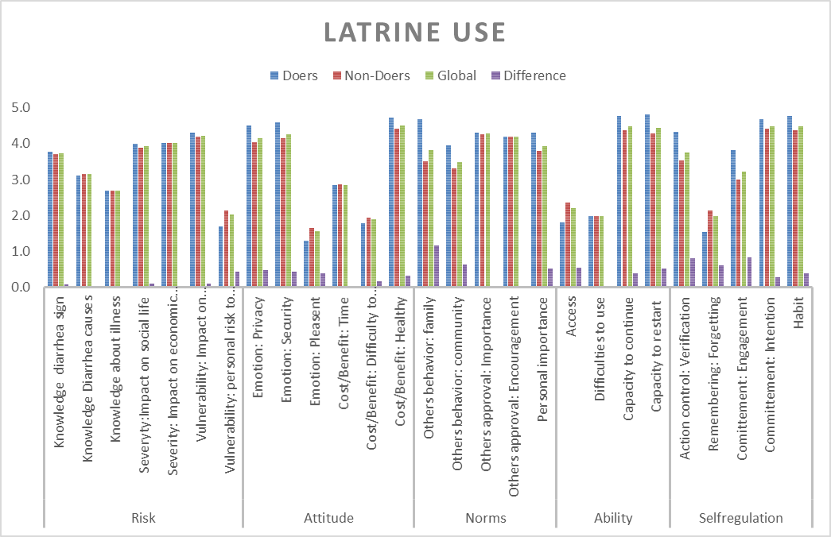
Potential of intervention: Mozambique
Notes:
Here is another example from Mozambique regarding latrine use. In the green circle there is no need for an intervention. There is a big diffence between doers and non-doers for the factor circled in red. The intervention should target these areas.

Slide 33
Develop and design behavior change strategies
Conclusions from the analysis in Mozambique:
Risk factor: There is no big difference between doers and non-doers
→ no action needed
Norm and self-regulation factors: There are some big differences between the “Others’ behavior”, Action control, Remembering and Engagement factors → These are the factors to target
Condition of latrine: Differs between doers and non-doers → this might have an influence on the use
Next steps:
Use the Behavior Change Technique list to define a possible intervention for the identificated factors.
Choose the communication channels
Describe the interventions precisely

Slide 34
Develop and design behavior change strategies
Example for latrine use in Mozambique
Today’s situation | Tomorrow’s situation | How we can achieve it
What non-doers think about the behavior | What we want the target individuals to think and feel about the behavior tomorrow: | How we will achieve this (BCT)
Risk factor: There is no significant difference between doers and non doers | No change required | No intervention required
Attitude factors It is not safe and there is not enough privacy to use a latrine. | I feel safe using a latrine. I have privacy when using my latrine. | BCT 8: Decribe positive feeling when using latrine
Norm factors: Not many of my family use the latrine. Not many of the community use the latrine. | Most of my family members use the latrine. Most of the community uses the latrine. | BCT 9: Inform about other’s behavior BCT 10: Prompt public commitment
Capacity factor: It is difficult to access the latrine. | It is easy to access the latrine. | BCT 15: Provide instruction BCT 20: facilitate resources BCT 21: Organize social support
Self-regulation factors: I do not check if the latrine is clean. I do forget to use the latrine. I am not committed/motivated to use the latrine. | I check the latrine’s condition. I always remember to use the latrine. I am committed to maintaining and using a latrine. | BCT 36 Agree a behavioral contract BCT 10 Prompt public commitment
Notes:
With this table we identify, what should change in the perception of the non-doers in future and which BCT from the BCT catalogue could be used.

Slide 35
Risk factors
Information behavior change techniques (BCTs) ==> Risk Factors
Presenting facts / knowledge transfer: communicate circumstances and possibilities of contracting a disease (e.g. verbal presentation, pictures, movies).
➔ F-Diagram / Information intervention / Material
Personal risk information: individualised messages focusing on cumulative risk effects and presenting individual examples / to request people to assess their own susceptibility
Showing scenarios: presenting situations in the person’s everyday life where she or he is at risk of contracting the disease
Risk info vulnerability / Material
Fear arousal: use threat-inducing arguments by stressing the severity of contracting a disease (graphic illustration of pain or distress, bodily disabilities or decay, and even death)
Notes:
You can find a whole set of interventions related to each behavioral factors in the behavior change technique list. These are just a few examples.

Slide 36
Attitudinal factors
Persuasive BCTs ==> Attitudinal factors
Persuasive arguments: use causal explanations; explain usefulness; present novel and important information with a high positive expectancy value
➔ Persuasion costs / Cuba persuasion
Persuasive peripheral cues: competence, sympathy, credibility, fame, publicity of the source; length and number of arguments in the message
Talking to others: self-persuasion by generating and reminding oneself of arguments supporting the new behavior.
Affective persuasion: presenting the performance of a healthy behavior as pleasant or joyful; or provoking aversion towards an unhealthy behavior.

Slide 37
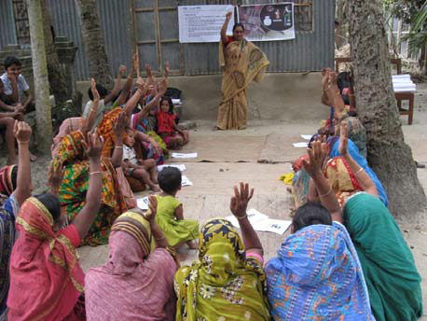
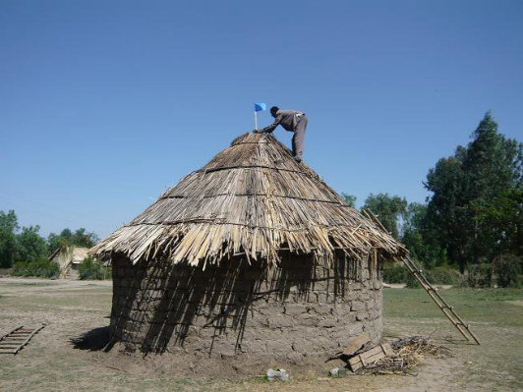
Norm factors
Highlighting norms: pointing out a desired behavior or reducing “social pressure” for an unfavourable behavior by referring to a favourable injunctive norm.
A message that an undesired behavior is regrettably frequent is counterproductive! Injunctive normative messages about a strongly disapproved-of behavior are effective.
Informing people about others’ approval/ disapproval: say that important people (e.g. traditional leaders) support the desired behavior or disapprove of the unhealthy behavior
Public commitment: encourage people to make a public commitment to a favourable behavior
Anticipated regret: pre-empt the concerns and regret people would feel if they perform undesired behaviors which are not consistent with their personal norms of healthy living.

Slide 38
Ability factors
Setting up infrastructure: (help with) providing the necessary infrastructure (e.g. vessels for water collection, filters for filtering water, etc.) is a precondition for performing the behavior.
Cuba infrastructure / Tippy Tap
Guided practice: skill demonstration, instruction about the desired behavior, enactment with feedback about the correctness of the performance.
Facilitating resources: direct financial help or the person has to make some effort to obtain the resources.
Provide instruction: conveying know-how in order to improve a person’s knowledge about how to perform the behavior.

Slide 39
Ability factors
Modelling: persons who perform the behavior and are perceived as competent and successful serve as behavioral models.
Reattribution of past successes and failures: self-efficacy is fostered if failures are not attributed to the particular person but to adverse circumstances; by contrast, successes should be attributed to the particular person.
Coping with barriers: identifying barriers and planning solutions for behavior change
Coping with barriers / Maintenance Plan
Coping with relapse: identifying risky situations where people might fall back into the old behavior; plan coping responses and practice these responses until they become automatic.

Slide 40
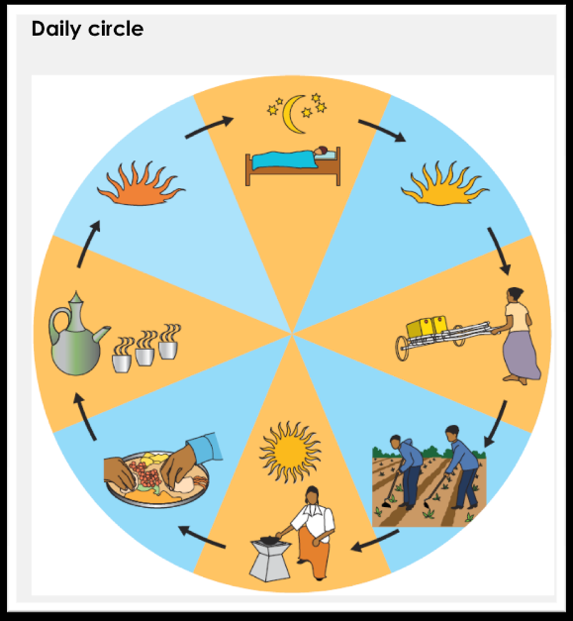
Self-regulation factors
Daily routine planning: prompt a person to plan exactly when to perform the desired behavior in the course of her daily life; discuss with the person when and where the new behavior can be integrated into their daily routine.
Outcome feedback: feedback is given on the effects (e.g. health effects) produced by the desired behavior, or else the person checks these effects herself (self-feedback).
Contingency management: prompt the person to develop her own incentive system so that she is rewarded each time she performs the desired behavior.
Stimulus control: remove reminders or cues for old behaviors, and add cues or reminders for the new behavior

Slide 41
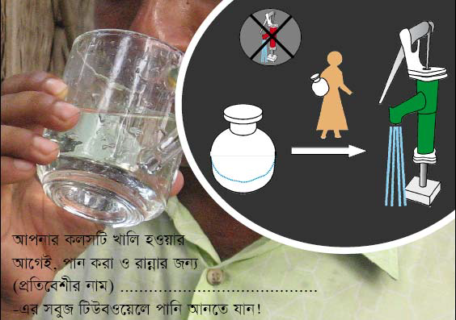
Self-regulation factors
Forming implementation intentions: stimulate the person to express when, where and how to intend to achieve his or her goals.
Implementation intention
Prompts: memory aids which trigger the right behavior in the right situation and help the person to remember the new behavior
➔ Prompt / Material

Slide 42
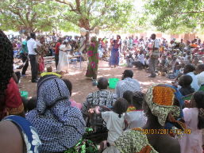
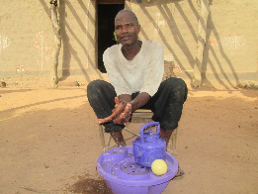
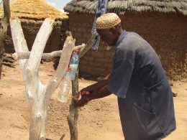
New intervention in Mali
 | Behavior factor | Intervention BCT | Intervention with communication channels
Norm factor | Others‘ behavior | Inform about behavior of others | Theater dealing with norm issues; pictures of handwashing families
 | Others‘ approval/disapproval | Inform about other‘s approval | Commitment of the head of the family with picture
Self-regulation factor | Forgetting | Prompt instruction forTippy Tap | Prompt with village chief in the household
Notes:
Here is an example, how the project in Mali has developed the new intervenion. The biggest change is not the communication channel but the content of the message

Slide 43
Phase 4
Phase
1. Identify potential behavioral factors
2. Measure and define behavioral factors
4. Implement and evaluate behavior change strategies
  Implement different strategies
  Develop final questionnaire and conduct evaluation survey
  Define most effective strategy and adapt interventions
3. Select behavior change techniques (BCTs) and design behavior change strategies
4. Implement and evaluate behavior change strategies

Slide 44
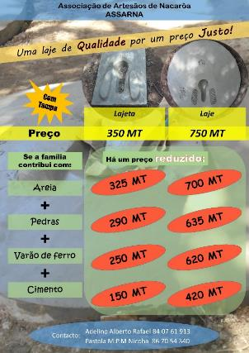
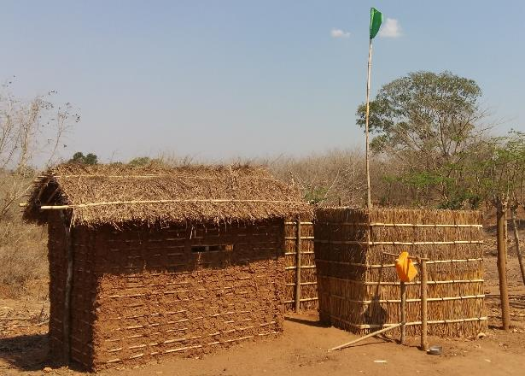
Implement the strategies
Evaluation ODF
Evaluation post-ODF
2nd Evaluation post-ODF
Min. 6 months
2-3 months
  Signature of families’ pledges to maintain the latrine
  Visual recognition of the families
  Promotion slab by the private sector
  Visual recognition of the families
Notes:
It is important to define a clear protocol of your intervention with an adequate timing. Here is an example of Mozambique with the first step of a public committement of the household to maintain and use their latrine. Then the evaluation of the latrine condition with a visible recognition in form of a small flag only for the households meeting the criteria of well-maintained and used latrine. This increases the norm of having a well maintained latrine. Then a third step to allow the households not meeting the critiera in the first evaluation to get a recognition.

Slide 45
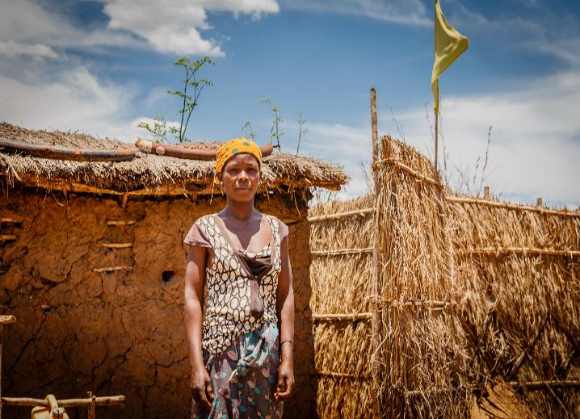
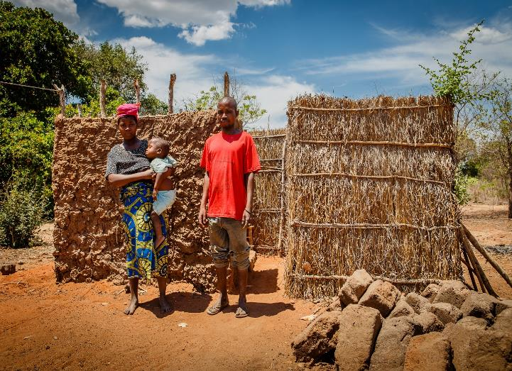
Results Mozambique
“This recognition (banner) is a big step forward for me. I will not agree to give it back again.” Filomena Rafaele, Namige village, Mozambique
“I would not only like to have a well-maintained latrine but also recognition (banner) showing I’m at the same level as the other families.” Theresa Antonio, Filomena’s neighbor
Notes:
Here are some statements of households after the recognition event.

Slide 46
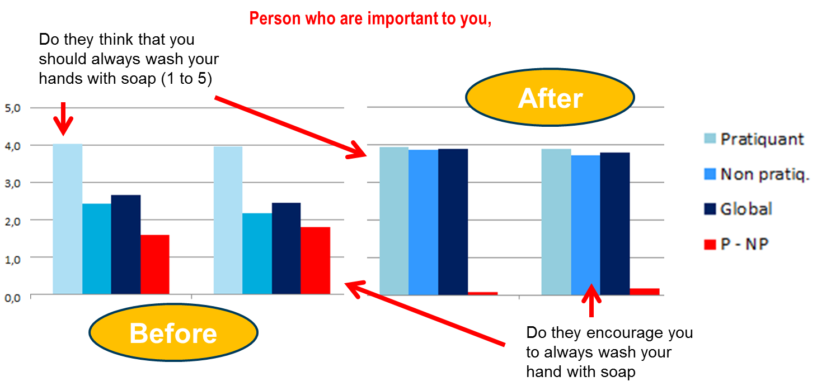
Evaluation of the intervention in Mali
Where was the intervention received by the target person?
Which intervention was most popular?
Did the targeted factor change?
What aspect of our interventions do we need to adapt?
Notes:
After a certain period of implementation an evaluation is made to see how the behavior and the behavioral factors have changed.
It was great for the Mali team to see a rise of 33.2 % in handwashing behavior. The comparison showed that there was a great change in the norm factor, which we had chiefly targeted with our intervention, but it also showed us that we have to adapt our strategy for self-regulation factors. The questions about how much the households liked the various interventions helped us to identify those that doers and non-doers liked most, and also indicated whether the intervention had reached everybody. The data and analysis help us to know what works and what doesn’t, which eliminates a lot of the guesswork and assumptions we had to resort to in the past.

