Slide 1
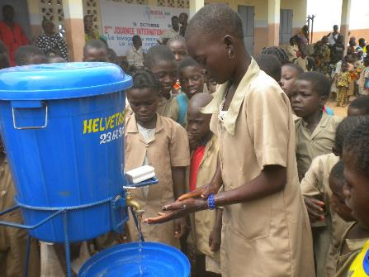
Behavior Change Workshop: Introduction
HELVETAS
Based on the Eawag presentation

Slide 2
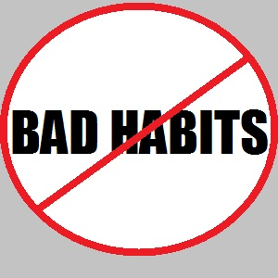
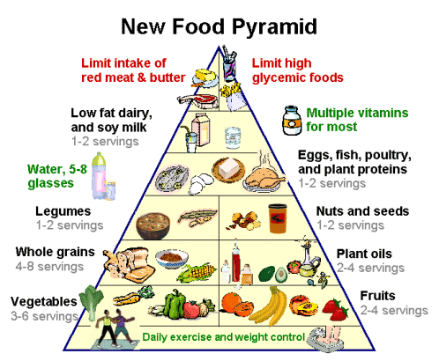
Introduction
Which of your own behaviours have you wanted to change?
When did you last change a behavior of your own?
Notes:
Before starting the presentation, do a brainstorming session with participants about their own behaviors. You can then refer back to these behaviors during the whole session as a practical example, which will help people to get a better understanding of the concept as a whole.

Slide 3
Goal of Session 1
Increase knowledge about behavior change and introduce the RANAS approach
Share people’s own experiences
Become familiar with the Ranas model
Know the factors that determine behaviors

Slide 4
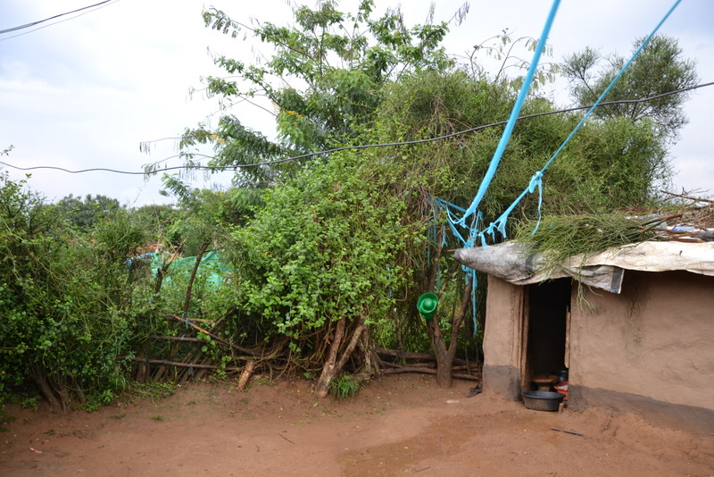
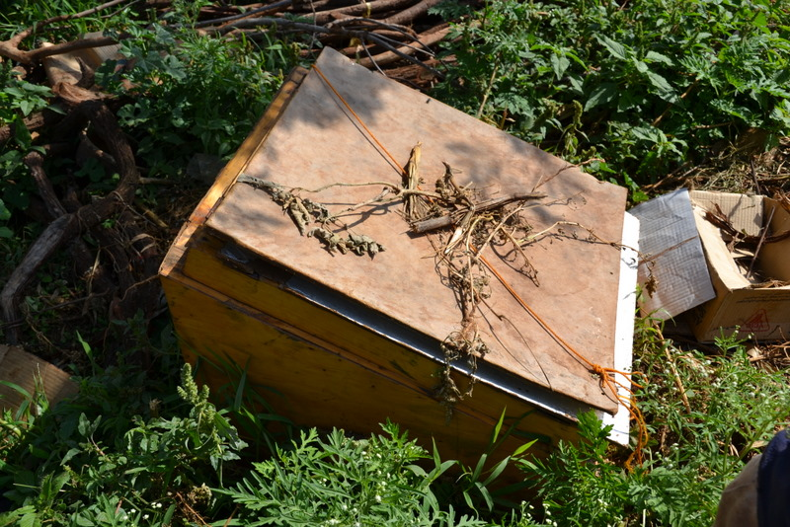
Why do behavior change?
Hardware: misuse
Notes:
Misuse of a mosquito net as a clothes line. Solar cooker used for storage.

Slide 5
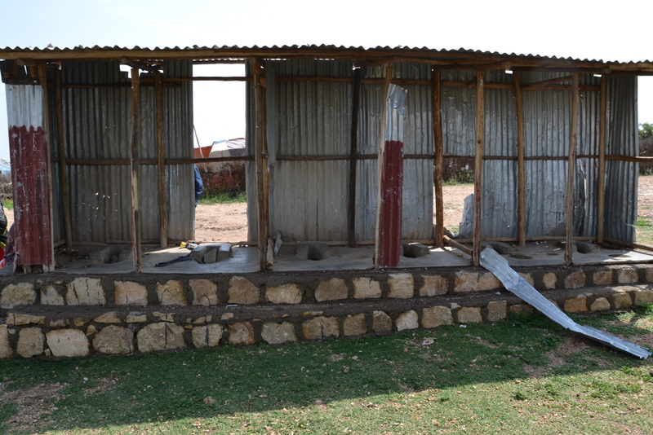
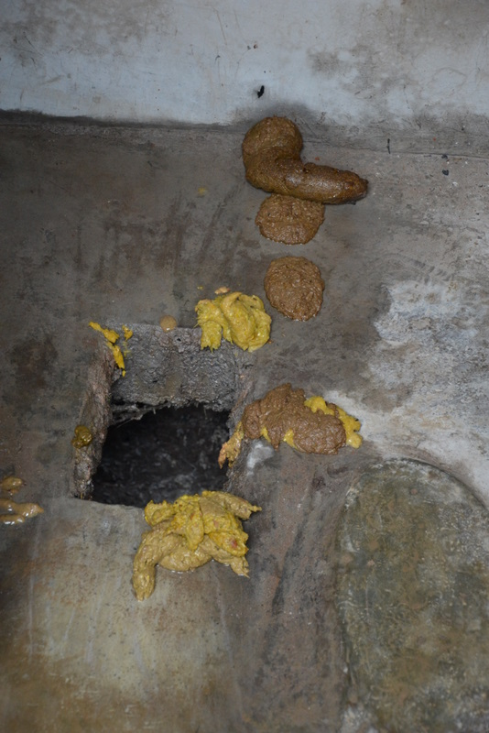
Why behavior change?
Hardware: badly used
Notes:
Badly used toilets, unmaintained public toilets and dirty toilets do not encourage use

Slide 6
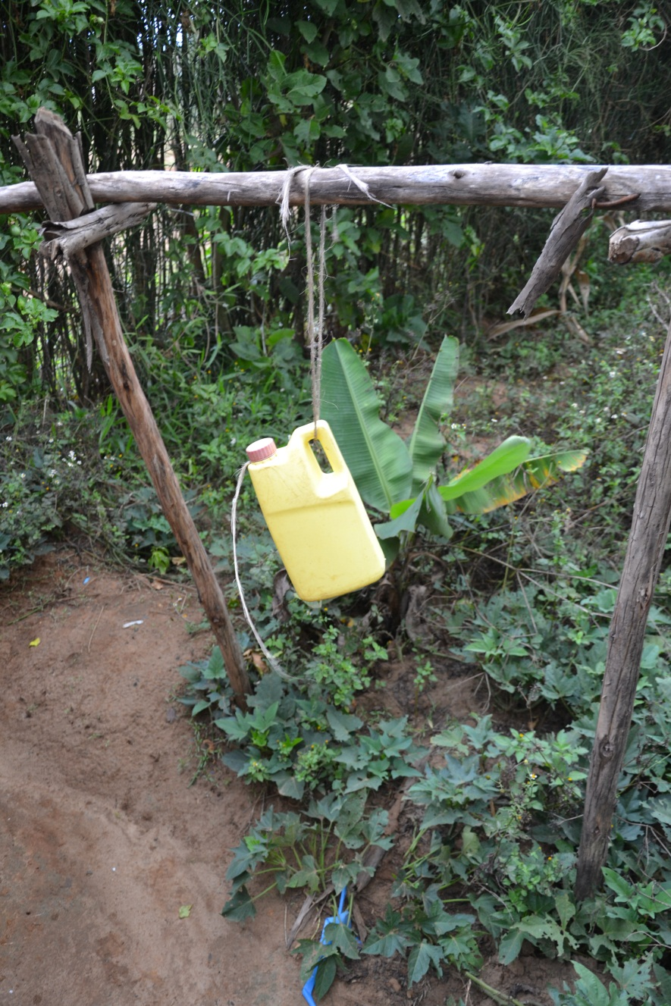
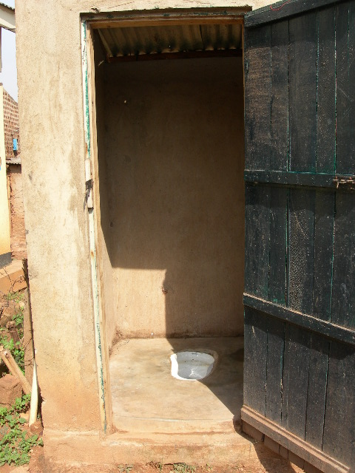
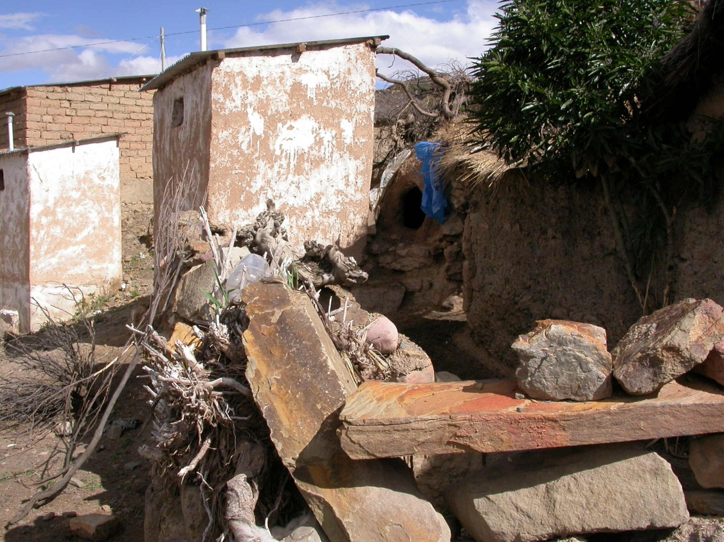
Why behavior change?
Hardware: not used at all
Notes:
Abondoned Tippy tap, new and not used toilets

Slide 7
Your own experiences
Own experiences?
What are your experiences of behaviour change in your project work?
Which kinds of behaviour change approach do you know?
Notes:
Here it is good to collect people‘s different experiences, which can be used as examples in open discussion during the further sessions.
Collecting known behavior change approaches will also help you to gauge the level of knowledge within the group.

Slide 8
What determines hardware use?
Supply with “Hardware”
Person
Use / Compliance
Notes:
We thought that providing infrastructure will initiate use. P.ex. Providing a toilet → latrine use, ceramique filter → treated water. But there is a person in the middle and we do not know what is happening in the head of this person. This is a black box and we will need more information on this black box

Slide 9
Behavioral factors determine how hardware is used
Hardware
Supply with bucket and chlorine
Person
Software
Behavior Change
Technique
Factor A
Factor C
Factor B
Factor D
Drinking disinfected water
If we know which behavioral factors are affected by the Behavior Change Technique (BCT)
then we can apply more goal-oriented BCTs and improve strategies
Notes:
People have different factorsin their minds that influence their behavior, such as factors A, B, C and D. These factors determine whether the person performs the behavior or not. Through our behavior change techniques we want to influence these factors so that the person will perform the behavior. To plan these interventions as effectively as possible we need to know which behavioral factors are in people‘s minds.

Slide 10
Behavioral factors…
determine if and how the material is used.
Hardware
Supply of tippy tap
Person A
Person B
Factor A
Factor C
Factor A–
Factor C–
Factor B
Factor D
Factor B–
Factor D–
Handwashing
No handwashing
Notes:
Behavioral factors can have a positive or a negative influence on a person‘s behavior. When we compare thebehavioral factors of people doing the behavior and those who aren‘t doing it, we can identify the ones that are relevant for doing the behavior.

Slide 11
Behavioral factors…
determine if and how the material is used.
Hardware
Software
Supply of a tippy tap
Behavior Change Techniques (BCT)
Person B
Person B
Factor A–
Factor C–
Factor A
Factor C
Factor B–
Factor D–
Factor B
Factor D
No handwashing
Handwashing
Notes:
Once we have identified behavioral factors such as A, B, C and D in this case, we choose the Behavior Change Techniques that are likely to influence them in order to change them and get the person to do the desirable behavior.

Slide 12
RANAS approach
Software
TCC 2
TCC 1
Person
Factor A
Factor C
Factor B
Factor D
Handwashing
Which behavioral factors determine the behavior?
Which factors are affected by which behavior change techniques?
➔ Develop more targeted technique and improve strategies
Notes:
To define the appropriate software intervention, we need to ask ourselves questions 1 and 2.

Slide 13
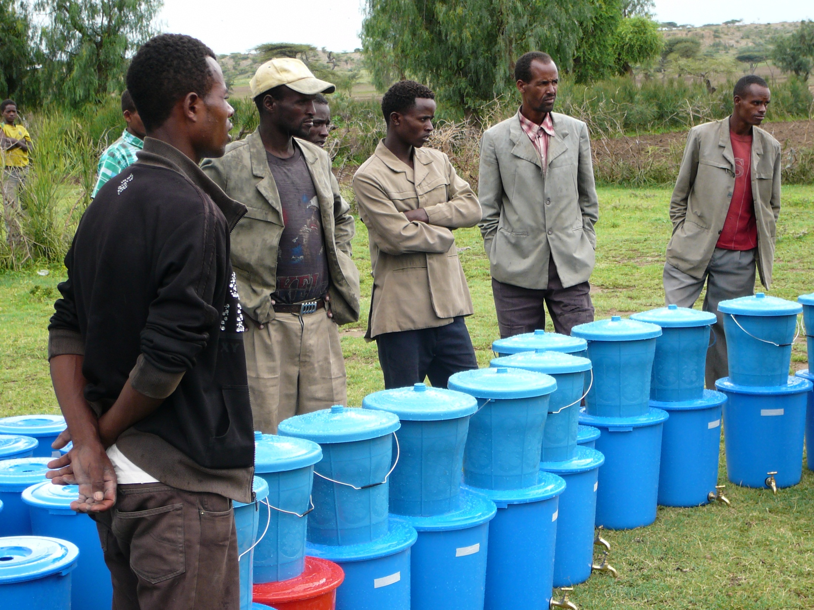
How do I manage it?
What does it cost and bring me?
What will other people say?
Do I like it?
Am I at risk? Why?
Can I do it?
Notes:
This is a common situation in a project. It involves promoting fluoride filters in a community. Information is given to the community about the filters, and they are encouraged to use it to improve the quality of their drinking water. In this situation, the participants have a lot of questions in their heads: Am I at risk? Why? Is my water at home really contaminated? etc.
What does it cost or bring me? I have to buy a filter, but is this one worthwhile? What are the advantages/disadvantages, etc.
Do I like it? Will the water have the same taste? Does it look nice?
How do I manage it? Will my wife have the time to fill it, and when? What will I do if I have to replace the granulars? etc.
What will other people say? Will they think I‘m a fool of spending money on this? Will they be proud of me because I look aftermy family‘s health? Will they say that I‘m a modern man?
Can I do it? Do I have the capacity/knowledge to do it? Where can I get the spare parts? Do I have room for it?
Normally we tend to answer on the questions about why and how to do it, and forget to answer the other questions.

Slide 14
Psychological factors for behavior change
Am I at risk? Why?
Risk factors:
Health knowledge
Vulnerability
Severity
Behavior A
Intention
Use
Habit
What does it cost and bring me?
Do I like it?
Attitude factors:
Beliefs about costs and benefits
Feelings
What will other people say?
Norm factors:
Others’ behavior
Others’ (dis)approval
Personal importance
Behavior B
Intention
Use
Habit
Can I do it?
How do I do it?
Ability factors:
How-to-do knowledge
Confidence in performance
Confidence in continuation
Confidence in recovering
How do I manage it?
Self-regulation factors:
Action planning
Action control
Barrier planning
Remembering
Commitment
Mosler, H.J., (2012). A systematic approach to behavior change interventions for the water and sanitation sector in developing countries.
A conceptual model, a review, and a guideline. International Journal of Environmental Health Research, 22 (5), 431-449.
.
Notes:
These questions can be linked to different behavioral factors and sub-factors based on a psychological model.
As we have seen, there are different processes that lead to behavioral change. These processes are defined by different psychological factors, which lead to certain beliefs. These beliefs further influence the targeted behavior,which is habitual use!

Slide 15
The RANAS model:
R(isk), A(ttitudes), N(orms), A(bility) and S(elf-regulation)
Information behavior change techniques
Risk factors:
Health knowledge
Vulnerability
Severity
Behavior A
Intention
Use
Habit
Persuasive behavior change techniques
Attitude factors:
Beliefs about costs and benefits
Feelings
Norm behavior change techniques
Norm factors:
Others’ behavior
Others’ (dis)approval
Personal importance
Behavior B
Intention
Use
Habit
Infrastructural, skill & ability behavior change techniques
Ability factors:
How-to-do knowledge
Confidence in performance
Confidence in continuation
Confidence in recovering
Planning & relapse prevention behavior change techniques
Self-regulation factors:
Action planning
Action control
Barrier planning
Remembering
Commitment
Social context
Physical context
Personal context
Notes:
When explaining this model, quote a behavior that a participant identified at the beginning, e.g. smoking, and go through all the different factors and sub-factors in this example. For example, for smoking, health knowledge. Everyone knows about smoking‘s bad effects on our health (cancer) and the vulnerabilty is the person‘s perception of being at risk in terms of his smoking behavior, etc.
You can use the description in Annex 4 to help you.
There are specific techniques to influence each behavioral factor.
These factors influence a person‘s intention to do a behavior, use/behavior and habit forming
Social (culture, tradtion, law and policies), Physical (natural environment, seasonality) and personal (e.g. sex, age) context can influence them too.

Slide 16
Evidence-based behavior change protocol
Evidence based behavior change protocol
Phase 1. Identify behavioral determinants
Define the behavior that needs changing and the target population to be tackled
Conduct qualitative interviews about the favoring and hindering contextual factor of the behavior
Allocate behavioral factors to the factors of the RANAS model
Phase 2. Measure behavioral determinants
Develop a questionnaire to measure behavioral factors and behaviors, and carry out observations
Conduct a representative baseline survey
Determine the factors that steer the target behavior
Phase 3. Select behavior change techniques (BCTs) and design a behavior change strategy
Select BCTs to change behavior steering factors
Develop and design behavior change strategy (including definition of communication channel, etc.)
Phase 4. Implement and evaluate promotion strategies
Implement the interventions
Do a follow-up survey
Adaptation of the strategy if needed
Notes:
We now know that we have to identify the behavioral factors to design our intervention better , but how? The Ranas approach defines 4 phases.
Phase 1: Identify potential behavioral factors. In this step, the behavior that should change and the target group have to be defined, information about contextual factors collected and linked to the behavioral factors.
Phase 2: Measure & determine the behavioral factors. Here, we develop a questionnaire to measure the factors through questions about the behavior and addressing the factors; conduct the baseline survey and identify the factosr that steer the behavior. This is done by comparing doers and non-doers.
Phase 3: Select BCT and design interventions. Based on the results of step 2, and with the help of the BCT catalogue, interventions are chosen to trigger the identified factors. The behavior change strategy is then set up
Phase 4: Implement and evaluate. The BH strategy is implemented. After half a year or a year, a follow-up survey is done to see if the intervention has had an effect and to analyse which interventions were most effective and which need further adaptations.

